Slide 1

Software Engineering Skill Set
Sanjay Togadiya (RK Infotech ( www.rkinfotechindia.com )
Notes:
1

Slide 2

What we learn?
Current Technologies
Skill Set
Type of Jobs
Opportunity
Do & Don'ts
Notes:
1

Slide 3
















Current Technologies
Notes:
1

Slide 4



Current Advance Technologies
IOTS
Cloud Technologies
AI
VR / AR
Machine Learning
Notification (Swiggy, e-commerce)
Technologies into agriculture
Home automation
Machine automation like (CNC VMC)
AWS
Azure
GCC
Notes:
1

Slide 5

Skills
Hard Skills
Soft Skill s
Notes:
1

Slide 6

Hard Skills
OOPS
In depths knowledge of technologies
Code Debugging
Sudo Code
R & D
Use cases, testing
Logic, reasoning & mathematics skill
Requirement Gathering & Analysis
Notes:
1

Slide 7
SOFT Skills
Management
  time, resource, money
Responsibility
  work, time, social
Communication Skill
Rules & Regulation
Reporting
  E-mail conversation, support tickets
Documentation
  requirement, planning, development, product, test cases
Notes:
1

Slide 8
SOFT Skills
New Technologies Awareness
Keen Observation Power
Coding guidelines
Time management
  Office, Client meeting, Work Priority, leave, working hours
Personality
  Cloth, Presentation, Gestures
Notes:
1

Slide 9

Digital Communications
Type of Jobs
Technical Jobs
Non Technical Jobs
Other Position
Notes:
1

Slide 10

Technical Jobs
PHP Developer
  Core PHP Developer
  Code-Igniter Developer
  WordPress Developer
  Laravel Developer
  WordPress Theme & Plugin Developer
  Drupal developer
  Ruby On Rail developer
  Python developer
  Magento developer
  Shopify developer
  OpenCart developer
  Odoo developer
  Opencv
  HTML Developer
    JavaScript developer
    jQuery developer
    React JS developer
    VUE JS developer
    Angular JS developer
    Node JS developer
    Web Designer
    CSS developer
Notes:
1

Slide 11
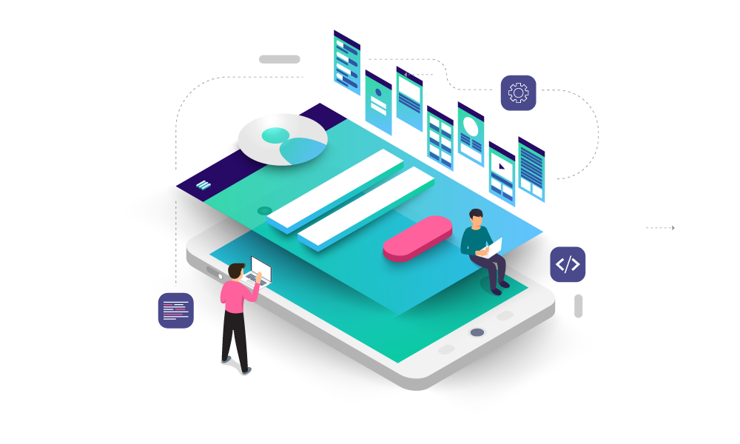
Technical Jobs
Android Developer
  Java Developer
  Kotlin Developer
  Flutter developer
  Game Developer
  IOTS Developer
  iOS Developer
    Swift Developer
    Objective C Developer
    Game Developer
    IOTS Developer
  Hybrid Developer
    Phone Gap Developer
    React Native Developer
    3D Unity developer
    Xamarin developer
    Ionic developer
.Net Developer
  WinForm Developer
  WPF Developer
  Web Developer
Notes:
1

Slide 12
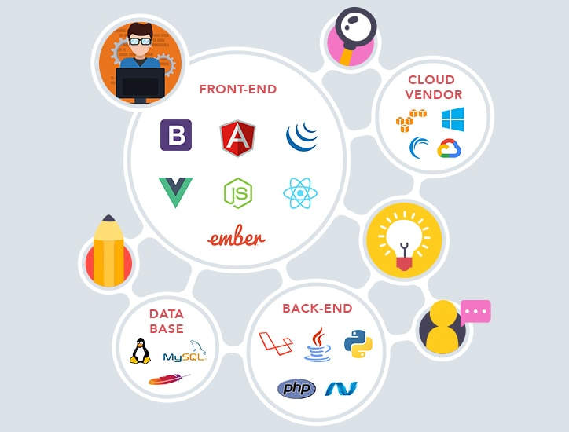
Technical Jobs
  Database Administration
    MSSQL, MySQL, Oracle, MongoDB, PostgreSQL, MariaDB, Amazon Aurora
  Mean Stack Developer
  Full Stack Developer
  DevOps
  Other Technical Position
    Network Admin,
    Server Admin
    Project Analysis
    Project Co-ordinator
    Project Architecture
    UI/UX Developer
Notes:
1

Slide 13
Non-Technical Jobs
  HR
  QA & Tester
  BDE / BDA
  Sales Executive
  Support Executive
  Graphic Design
  Tele caller
  SEO
  Lead Generator
  Digital Marketing Executive
  Content Writer
  Backlink Building
  PPC campaign manager
Notes:
1

Slide 14

Other Position
  Chip developer
  Device driver developer
  Embedded System development
  Raspberry pie
  Raspberry zero
  Ardino
Notes:
1

Slide 15
Do and Don't
Notes:
1

Slide 16

Do on jobs
  Training
  At lease do 2 year job into 1 company
  Focus on skill not a financial goal
  Self learning
    (Do study at least 2 year in starting career)
  Choose Proper company
    (Location, Goal, Technologies)
  Define Goal at least 10 years
  Give importance to work & Smart work
  Take more responsibility
  Away from Corporate Politics
  Create ability to do work other developer works
Notes:
1

Slide 17

Don’t do on jobs
  Never choose batch developer job company
  Don't do startup after study
  Don't a dependent developer
  Don't use social media into company
  Focus on your work only
  Don't dependent on technologies
  Don't wait for Opportunity, but create Opportunity
  Don't mix personal & professional life
  Don't Master immediately bachelor degree
  Don't accept rammers / misguide until you have evaluate it
Notes:
1

Slide 18

Thank You
Sanjay Togadiya
www.rkinfotechindia.com
www.linkedin.com/in/sanjaytogadiya
www.instagram.com/stogadiya135
Notes:
1

