Slide 1



Presented By,
Mr. Sanjay Togadiya
Founder, RK Infotech, Rajkot
Mr. Siddharth Jogia
Project Manager, RK Infotech, Rajkot
www.rkinfotechindia.com

Slide 2
About RK Infotech
RK INFOTECH is a leading IT company in Rajkot, India empowering business transformation for enterprises and technology providers by delivering customized, reliable and cost efficient solutions.
We believe in quality and always thrive to provide state of the art technology in all the relative fields.
5+ years experience IT company
27+ experts teams
Global Presence
400+ Domestic + International satisfied clients
www.rkinfotechindia.com

Slide 3


Our Mission
Head Office
Branch Office
Sister Companies
To be the best global IT Solution Company by providing exceptional cost effective solutions and services to our clients, surpassing their expectations and enhancing revenues at the same time.
SF-48, Shreemad Bhavan, Opp. Kanta Vikas Gruh Road, Bhaktinagar Main Road, Rajkot 360002 (Gujarat, India)
B-4/50C, Ashok Vihar,Phase-2, Near Sagar Ratna, New Delhi - 110052 (India)
www.rkinfotechindia.com

Slide 4
Our Products & Services
Software Products
Online Exam Software
Business ERP Software
Accounting Software
Question Paper Generator
USB Based Study Software
Bulk Cheque Printing Software
School College ERP System
Label / Barcode Printing Software
Store Management Software
Customized Solutions
e-Commerce Website
CMS Website
Business ERP
Financial Solution
CRM System
Working as IT Partners
IT Partners
IOTs
KPO
www.rkinfotechindia.com

Slide 5
Other Services & Connected Industries
Other Services
Website Development
Android App Development
iOS App Development
Software Development
Search Engine Optimization
Graphics Designs
Customized ERP Solutions
Customized CRM Solutions
Industries We Serve
Education & e- Learning
Automobile Industry
SME Industries
Financial Services
Real Estate
Hospitality & Healthcare
Logistic Services
Information Services
Travel & Tourism
Retail & e-Commerce Industry
www.rkinfotechindia.com

Slide 6
Today’s Discussion
Introduction to Agile
Agile Methods & Practices
  Detailed Understanding of Scrum Method
  Extreme Programming
  Hybrid Scrum with XP
Agile Documentation
www.rkinfotechindia.com

Slide 7
Introduction to Agile
www.rkinfotechindia.com

Slide 8
Agile History
In 2001, this new management paradigm began to pick up momentum, agile was formalized when 17 pioneers of the agile methodology met at the Snowbird Ski Resort in Utah and issued the Agile Manifesto.
Kent Beck
Mike Beedle
Arie van Bennekum
Alistair Cockburn
Ward Cunningham
Martin Fowler
James Grenning
Jim Highsmith
Andrew Hunt
Ron Jeffries
Jon Kern
Brian Marick
Robert C. Martin
Steve Mellor
Ken Schwaber
Jeff Sutherland
Dave Thomas
www.rkinfotechindia.com

Slide 9
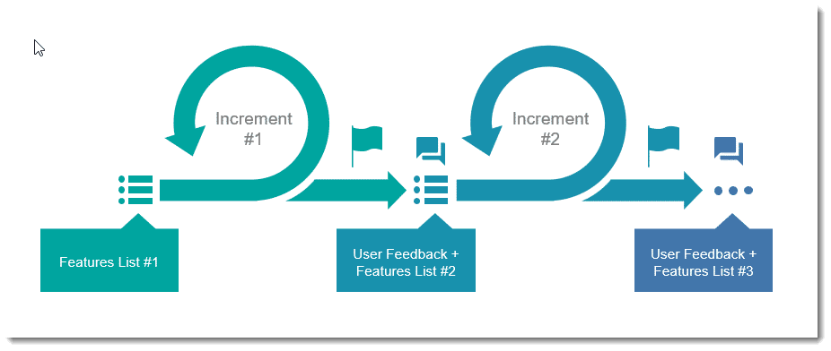
What is Agile?
Agile is a time boxed, iterative approach to software delivery that builds software incrementally from the start of the project, instead of trying to deliver it all at once near the end. It works by breaking projects down into little bits of user functionality called user stories, prioritizing them, and then continuously delivering them in short two week cycles called iterations.

Slide 10
How does it work?
You make a list
Sitting down with your customer you make a list of features they would like to see in their software. We call these things user stories and they become the To Do list for your project.
You size things up
You size(estimate) your stories relatively to each other, coming up with a guess as to how long you think each user story will take.
You set some priorities
Like most lists, there always seems to be more to do than time allows. So you ask your customer to prioritize their list so you get the most important stuff done first, and save the least important for last.
www.rkinfotechindia.com

Slide 11
How does it work? [Continue...]
You start executing
Then you start delivering some value. You start at the top. Work your way to the bottom. Building, iterating, and getting feedback from your customer as you go.
You update the plan as you go
Then as you and your customer starting delivering one of two things is going to happen. You'll discover:
You're going fast enough. All is good. Or,
You have too much to do and not enough time.
At this point you have two choices. You can either
do less and cut scope (recommended). Or
you can push out the date.
www.rkinfotechindia.com

Slide 12
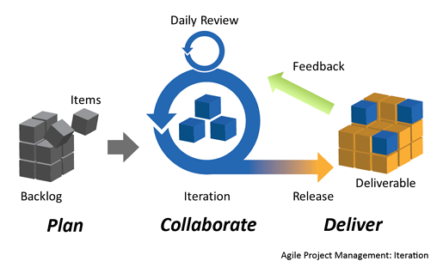
How does it work? [Continue...]
www.rkinfotechindia.com

Slide 13
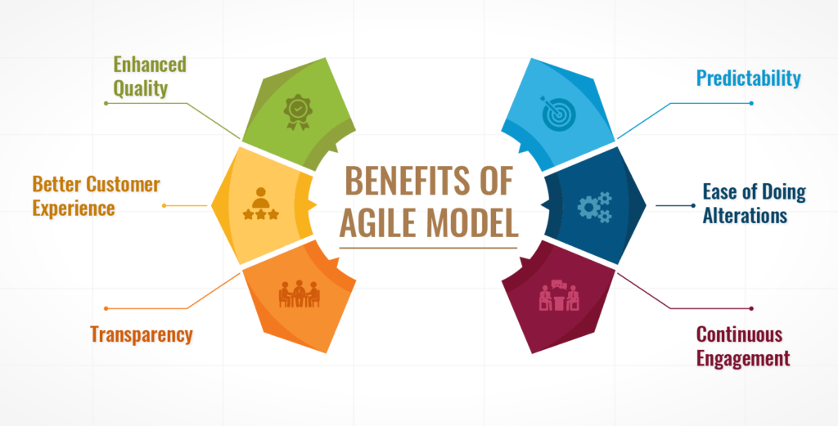
Why Use Agile Methods
www.rkinfotechindia.com

Slide 14
Advantages of Agile Model
Customer satisfaction by rapid, continuous delivery of useful software.
People and interactions are emphasized rather than process and tools. Customers, developers and testers constantly interact with each other.
Working software is delivered frequently (weeks rather than months).
Face-to-face conversation is the best form of communication.
Close, daily cooperation between business people and developers.
Continuous attention to technical excellence and good design.
Regular adaptation to changing circumstances.
Even late changes in requirements are welcomed
www.rkinfotechindia.com

Slide 15
Disadvantages of Agile Model
In case of some software deliverables, especially the large ones, it is difficult to assess the effort required at the beginning of the software development life cycle.
The project can easily get taken off track if the customer representative is not clear what final outcome that they want.
Only senior programmers are capable of taking the kind of decisions required during the development process. Hence it has no place for newbie programmers, unless combined with experienced resources.
www.rkinfotechindia.com

Slide 16
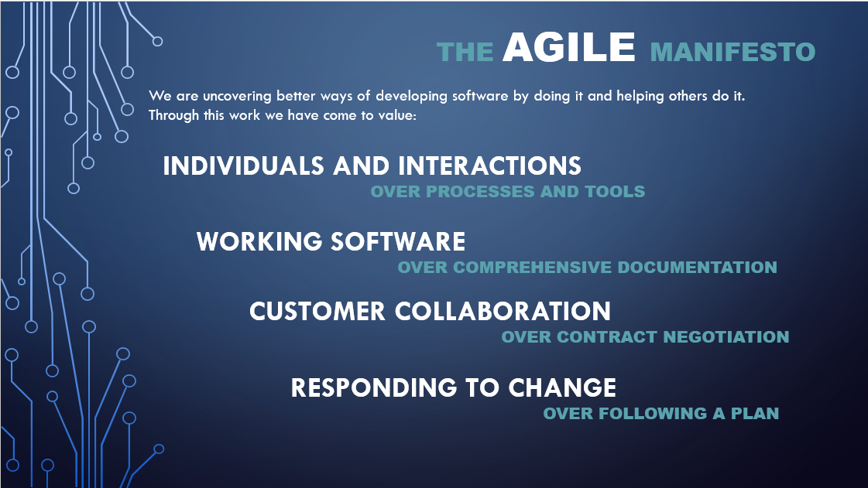
www.rkinfotechindia.com

Slide 17
The Twelve Agile Manifesto Principles
Customer satisfaction through early and continuous software delivery - Customers are happier when they receive working software at regular intervals, rather than waiting extended periods of time between releases.
Accommodate changing requirements throughout the development process - The ability to avoid delays when a requirement or feature request changes.
Frequent delivery of working software – Scrum accommodates this principle since the team operates in software sprints or iterations that ensure regular delivery of working software.
www.rkinfotechindia.com

Slide 18
The Twelve Agile Principles [Continue...]
Collaboration between the business stakeholders and developers throughout the project – Better decisions are made when the business and technical team are aligned.
Support, trust, and motivate the people involved – Motivated teams are more likely to deliver their best work than unhappy teams.
Enable face-to-face interactions – Communication is more successful when development teams are co-located.
www.rkinfotechindia.com

Slide 19
The Twelve Agile Principles [Continue...]
Working software is the primary measure of progress – Delivering functional software to the customer is the ultimate factor that measures progress.
Agile processes to support a consistent development pace – Teams establish a repeatable and maintainable speed at which they can deliver working software, and they repeat it with each release.
Attention to technical detail and design enhances agility – The right skills and good design ensures the team can maintain the pace, constantly improve the product, and sustain change.
Simplicity – Develop just enough to get the job done for right now.
www.rkinfotechindia.com

Slide 20
The Twelve Agile Principles [Continue...]
Self-organizing teams encourage great architectures, requirements, and designs – Skilled and motivated team members who have decision-making power, take ownership, communicate regularly with other team members, and share ideas that deliver quality products.
Regular reflections on how to become more effective – Self-improvement, process improvement, advancing skills, and techniques help team members work more efficiently.
The intention of Agile is to align development with business needs, and the success of Agile is apparent.
Agile projects are customer focused and encourage customer guidance and participation. As a result, Agile has grown to be an overarching view of software development throughout the software industry and an industry all by itself.
www.rkinfotechindia.com

Slide 21
The Twelve Agile Principles [Continue...]
Self-organizing teams encourage great architectures, requirements, and designs – Skilled and motivated team members who have decision-making power, take ownership, communicate regularly with other team members, and share ideas that deliver quality products.
Regular reflections on how to become more effective – Self-improvement, process improvement, advancing skills, and techniques help team members work more efficiently.
The intention of Agile is to align development with business needs, and the success of Agile is apparent.
Agile projects are customer focused and encourage customer guidance and participation. As a result, Agile has grown to be an overarching view of software development throughout the software industry and an industry all by itself.
www.rkinfotechindia.com

Slide 22
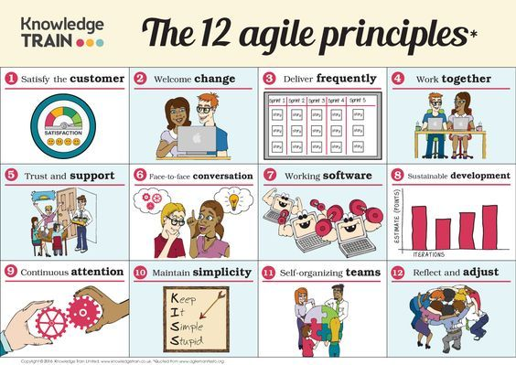
The Twelve Agile Principles [Continue...]
www.rkinfotechindia.com

Slide 23
Agile Methods & Practices
www.rkinfotechindia.com

Slide 24
What are Agile Methods?
Is this what we mean by agile method:
Class Agile
{
public function agileMethods () {
getMethod(Agile.agile);
}
}
www.rkinfotechindia.com

Slide 25
Definition by Agile Philosophy
Agile methods are processes that support the agile philosophy. Examples include Extreme Programming and Scrum, FDD, TDD, etc.
Agile methods consist of individual elements called practices.
Practices include using version control, setting coding standards, and giving weekly demos to your stakeholders.
Agile Methods combine these practices to accentuate parts that support agile philosophy.
www.rkinfotechindia.com

Slide 26
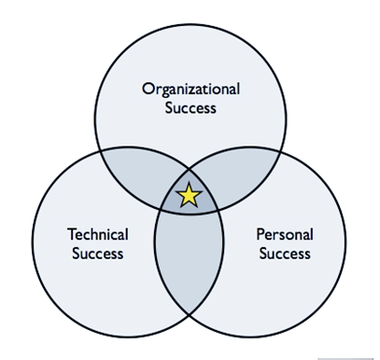
Aspect of Success with Agile Methods
Organization success is about delivering value – and agile philosophy has this at the heart of it.
Personal success is, well Personal, but everyone gains from improved collaboration.
Technical success, because of practices like TDD, Scrum and extreme programming you are continuously improving. This overlaps with personal.
www.rkinfotechindia.com

Slide 27
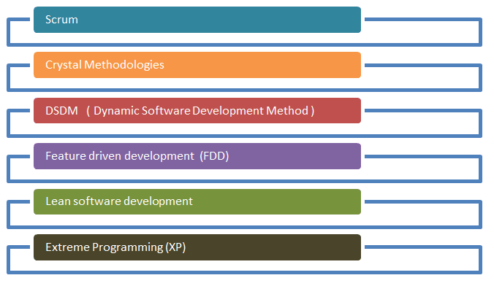
Well Known Agile Methods
www.rkinfotechindia.com

Slide 28
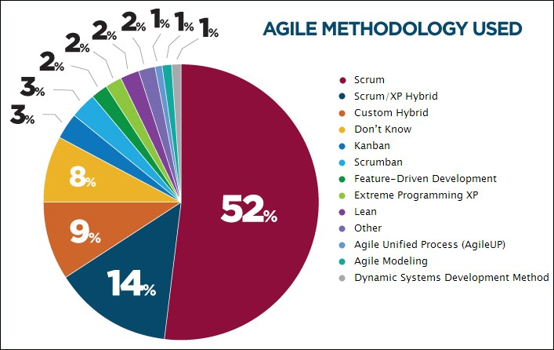
Agile Methods Usage Chart
www.rkinfotechindia.com

Slide 29
Introduction to Scrum Methodology
Scrum is an agile process that allows us to focus on delivering the highest business value in the shortest time.
It allows us to rapidly and repeatedly inspect actual working software (every two weeks to one month).
The business sets the priorities. Teams self-organize to determine the best way to deliver the highest priority features.
Every two weeks to a month anyone can see real working software and decide to release it as is or continue to enhance it for another sprint
www.rkinfotechindia.com

Slide 30
Scrum Characteristics
Self-organizing teams
Product progresses in a series of month-long “sprints”
Requirements are captured as items in a list of “product backlog”
No specific engineering practices prescribed
Uses generative rules to create an agile environment for delivering projects
One of the “agile processes”
www.rkinfotechindia.com

Slide 31
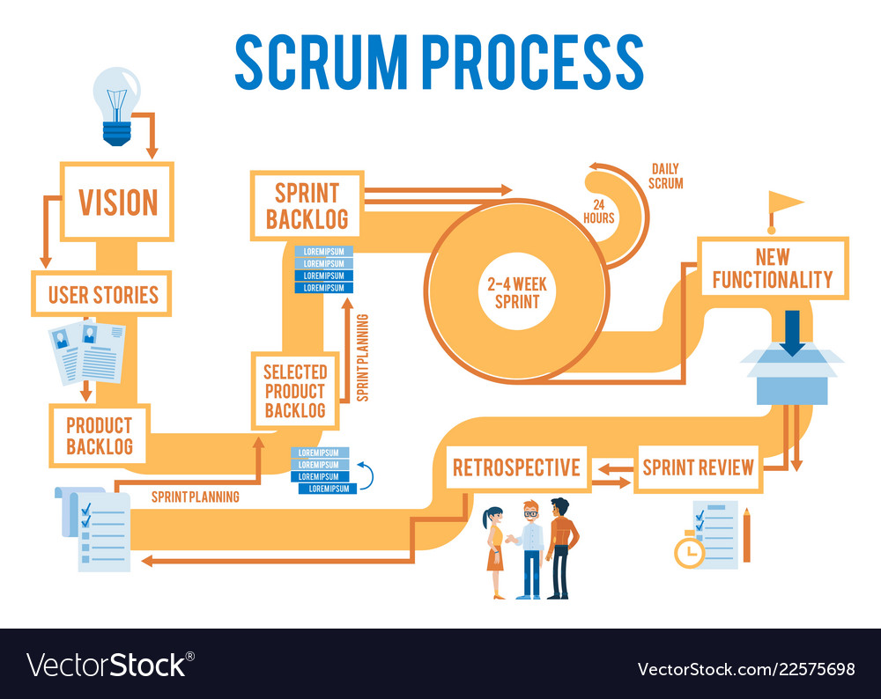
www.rkinfotechindia.com

Slide 32
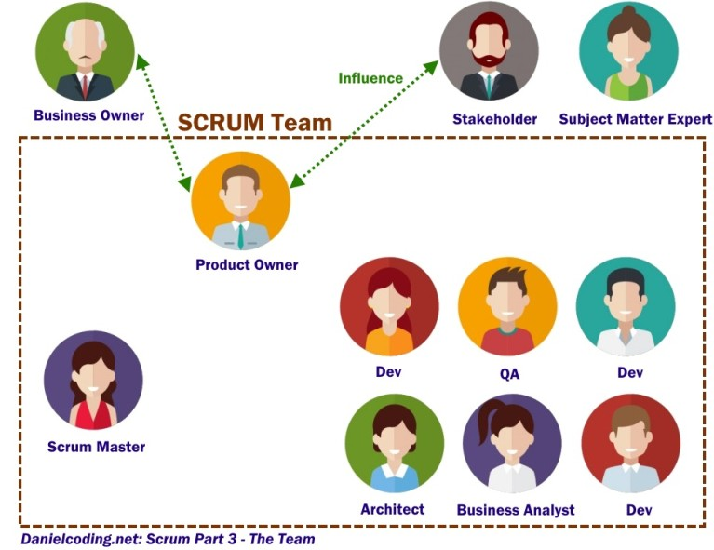
Scrum Team & Roles
www.rkinfotechindia.com

Slide 33

No Changes During sPrint
Plan sprint durations around how long you can commit to keeping change out of the sprint
www.rkinfotechindia.com

Slide 34
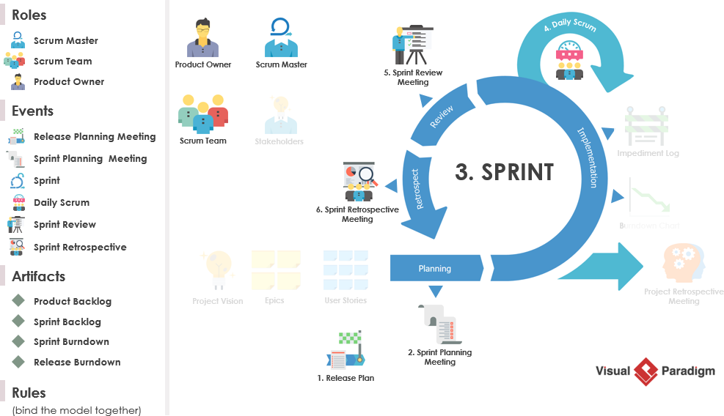

Slide 35
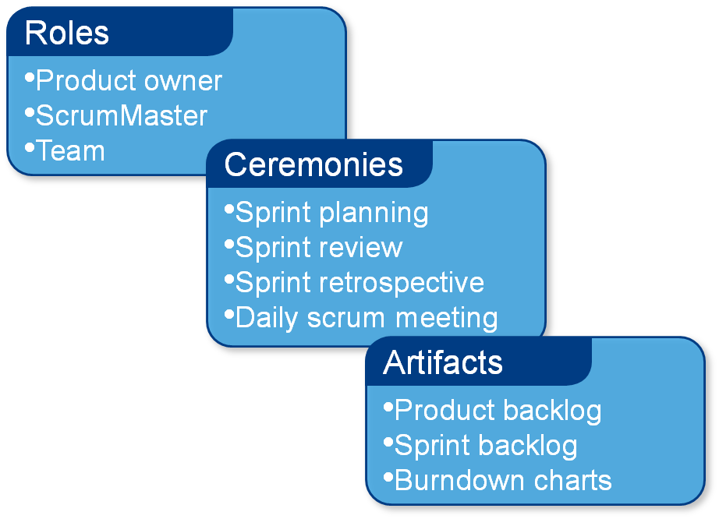
Scrum Framework
www.rkinfotechindia.com

Slide 36
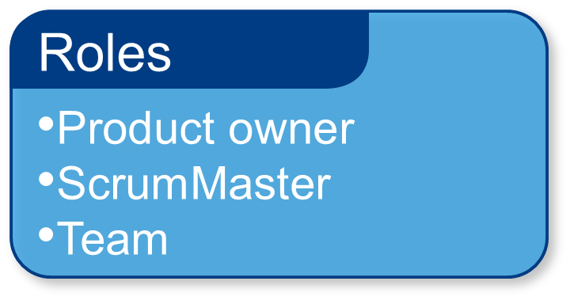
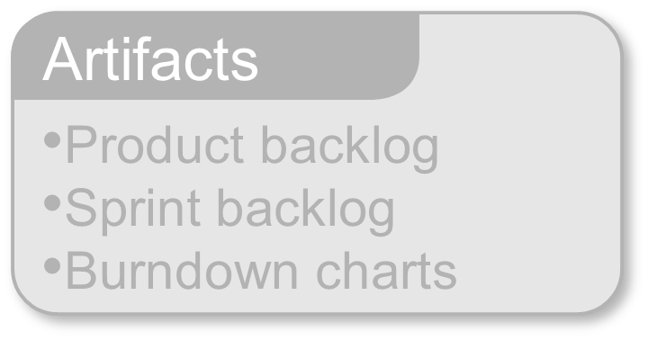
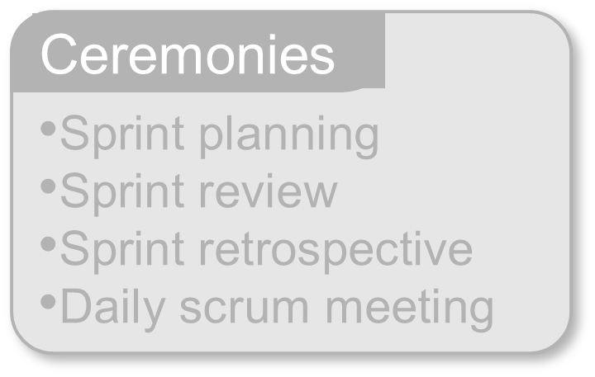
Scrum Framework [ Part 1 ]
www.rkinfotechindia.com

Slide 37

Product Owner
Define the features of the product
Decide on release date and content
Be responsible for the profitability of the product’s return of investment (ROI)
Prioritize features according to market value
Adjust features and priority every iteration, as needed
Accept or reject work results
www.rkinfotechindia.com

Slide 38

The ScrumMaster
Represents management to the project
Responsible for enacting Scrum values and practices
Removes obstruction in doing something
Ensure that the team is fully functional and productive
Enable close cooperation across all roles and functions
Shield the team from external interferences
www.rkinfotechindia.com

Slide 39
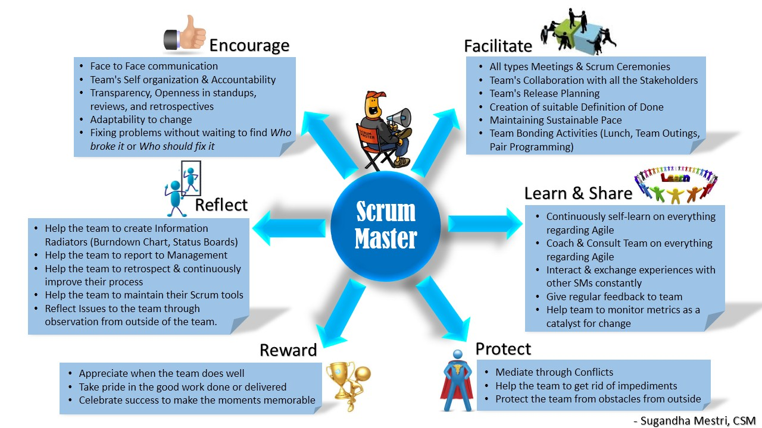

Slide 40

The Team
Typically 5-9 people who are self-organized
They are Cross-Functional
  Programmers, testers, user experience designers, etc.
Skilled in whatever is needed for the project
Members should be full-time
  May be exceptions (e.g., database administrator)
Scrum recognized no sub-teams in the development Team
Membership should change only between sprints
www.rkinfotechindia.com

Slide 41
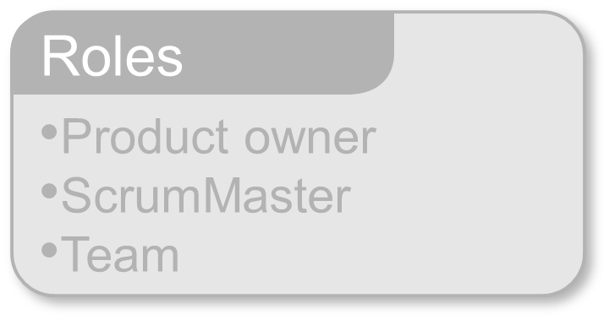
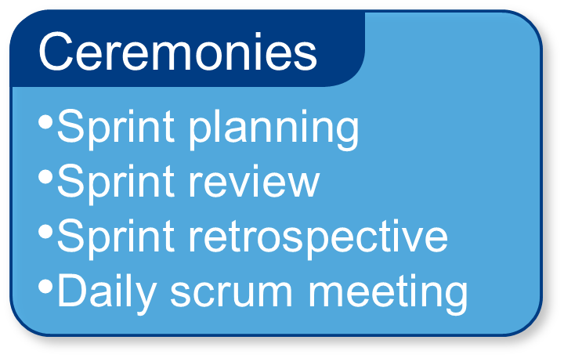
Scrum Framework [ Part 2 ]
www.rkinfotechindia.com

Slide 42
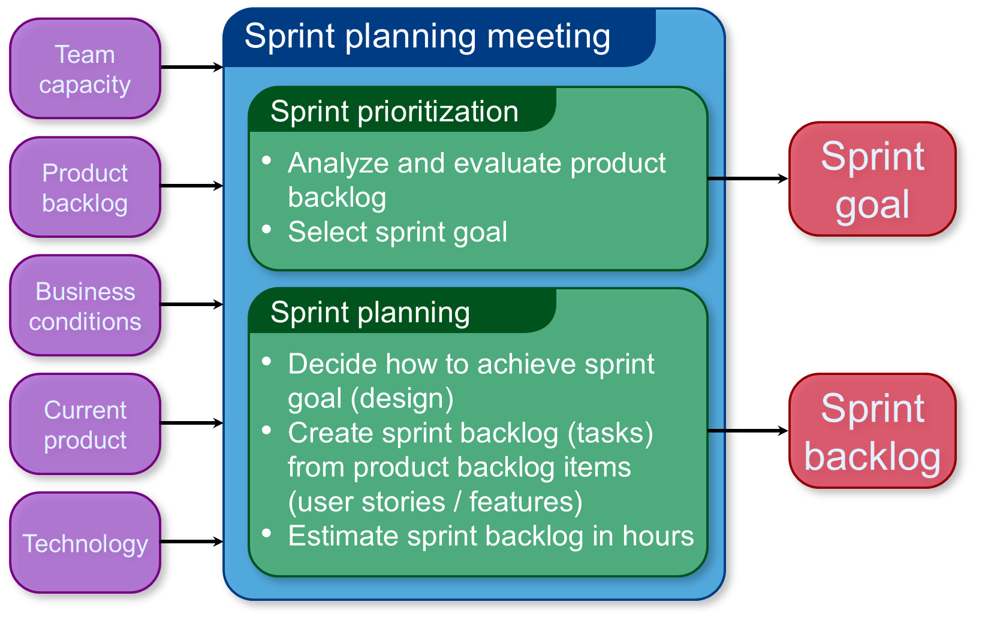
Sprint Planning
www.rkinfotechindia.com

Slide 43
Sprint Planning
Team selects items from the product backlog they can commit to completing
Sprint backlog is created
Tasks are identified and each is estimated (1-16 hours)
Collaboratively, not done alone by the ScrumMaster
High-level design is considered
Code the middle tier (8 hours)
Code the user interface (4)
Write test fixtures (4)
Code the foo class (6)
Update performance tests (4)
www.rkinfotechindia.com

Slide 44
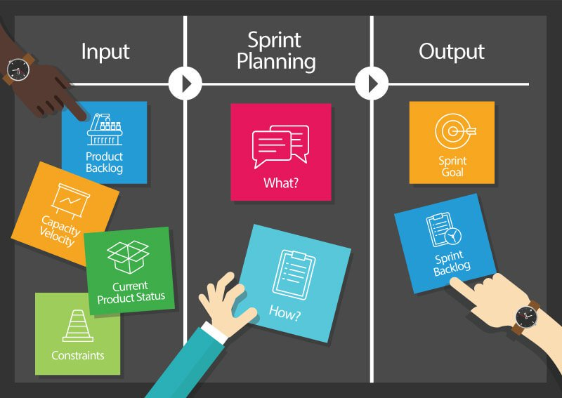
Sprint Planning
www.rkinfotechindia.com

Slide 45
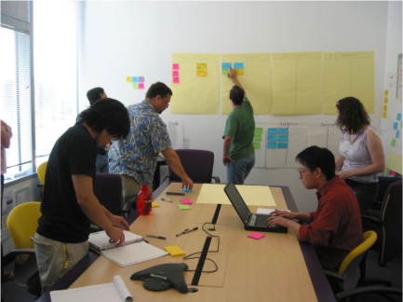
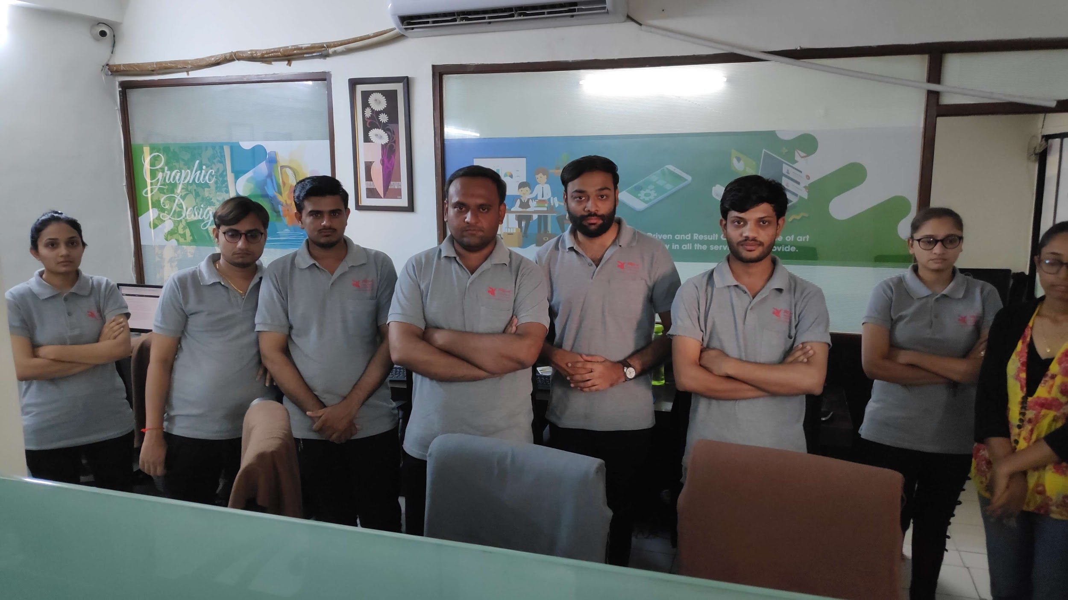
The Daily Scrum
Daily Activity Tracking
Quick Problem Solution
Daily 15-minutes Stand-up
Project Current Status Analysis
Helps avoid other unnecessary meetings
Not for problem solving
  Whole world is invited
  Only team members, ScrumMaster, product owner, can talk
www.rkinfotechindia.com

Slide 46
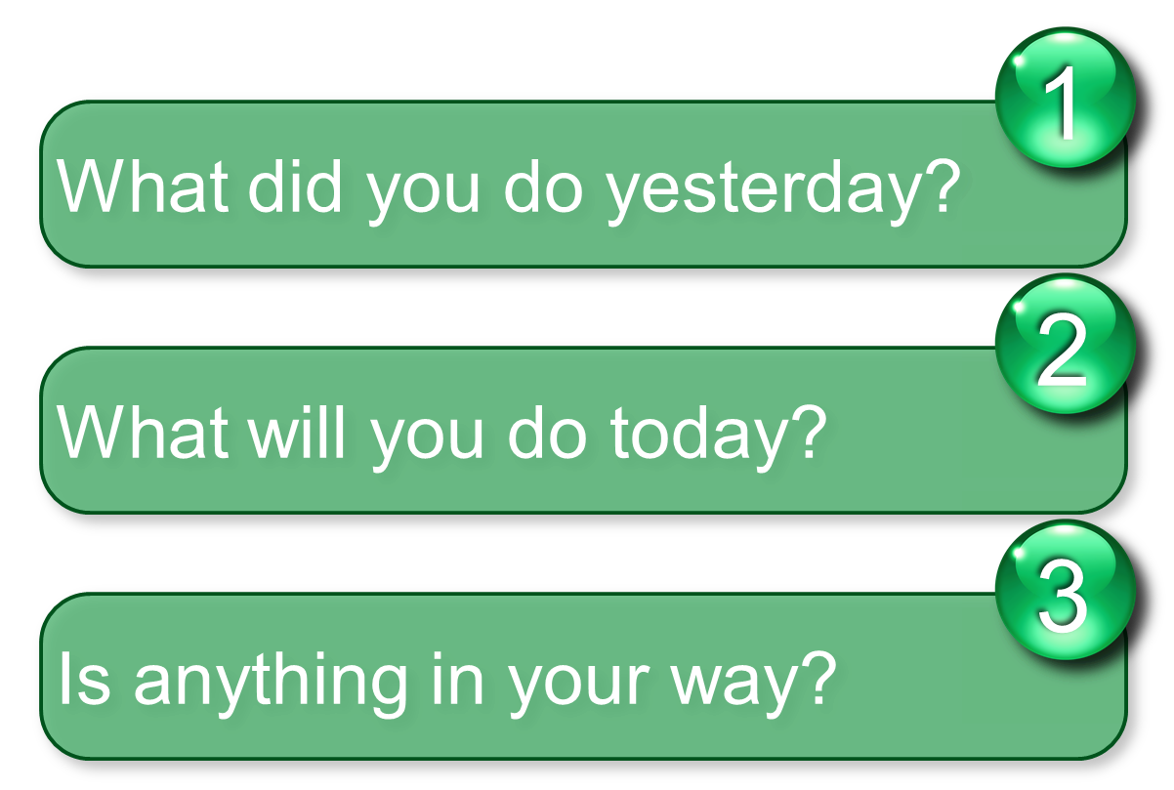
Everyone answers 3 questions
These are not status for the ScrumMaster
  They are just team member’s commitments in front of other peers
www.rkinfotechindia.com

Slide 47


The Sprint Review
Team presents what it accomplished during the sprint
Typically takes the form of a demo of new features or underlying architecture
Informal Meeting
  2-hour prep time rule
  No slides
Whole team participates
Invite the world
www.rkinfotechindia.com

Slide 48
Sprint Retrospective
Periodically take a look at what is and is not working
Typically 15–30 minutes
Done after every sprint
Whole team participates
  ScrumMaster
  Product owner
  Team
  Possibly customers and others
www.rkinfotechindia.com

Slide 49
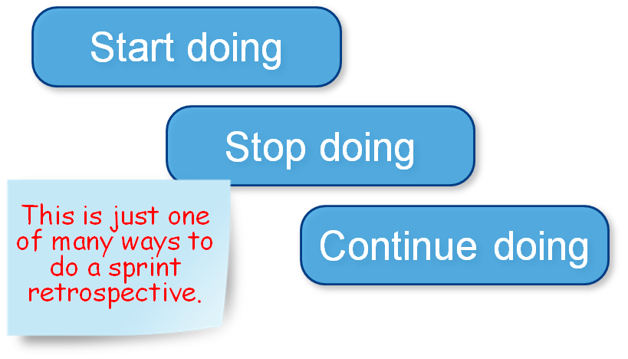
Sprint Retrospective
Whole team gathers and discusses what they’d like to :
www.rkinfotechindia.com

Slide 50
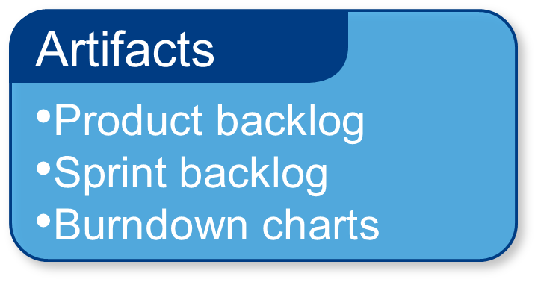
Scrum Framework [ Part 3 ]
www.rkinfotechindia.com

Slide 51
Product Backlog
The requirements
A list of all desired work on the project
Ideally expressed such that each item has value to the users or customers of the product
Prioritized by the product owner
Reprioritized at the start of each sprint
www.rkinfotechindia.com

Slide 52
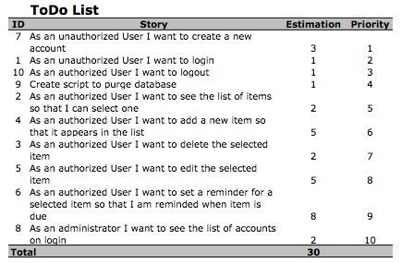
Product Backlog Example
www.rkinfotechindia.com

Slide 53
The Sprint Goal
A short statement of what the work will be focused on during the sprint
For Example :
Database Application
Make the application run on SQL Server in addition to Oracle.
Financial services
Support more technical indicators than company ABC with real-time, streaming data.
www.rkinfotechindia.com

Slide 54
Sprint Backlog
Individuals sign up for work of their own choosing
  Work is never assigned
Estimated work remaining is updated daily
Any team member can add, delete or change the sprint backlog
Work for the sprint emerges
If work is unclear, define a sprint backlog item with a larger amount of time and break it down later
Update work remaining as more becomes known
www.rkinfotechindia.com

Slide 55
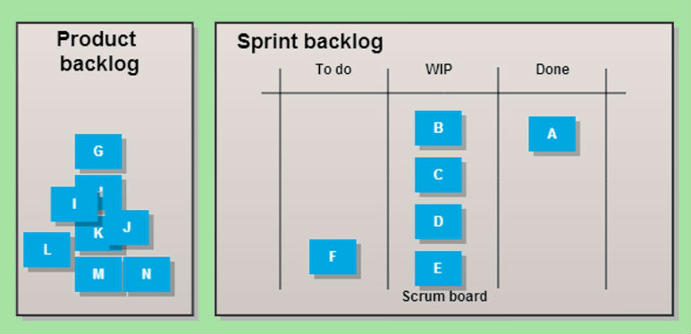
Sprint Backlog
www.rkinfotechindia.com

Slide 56
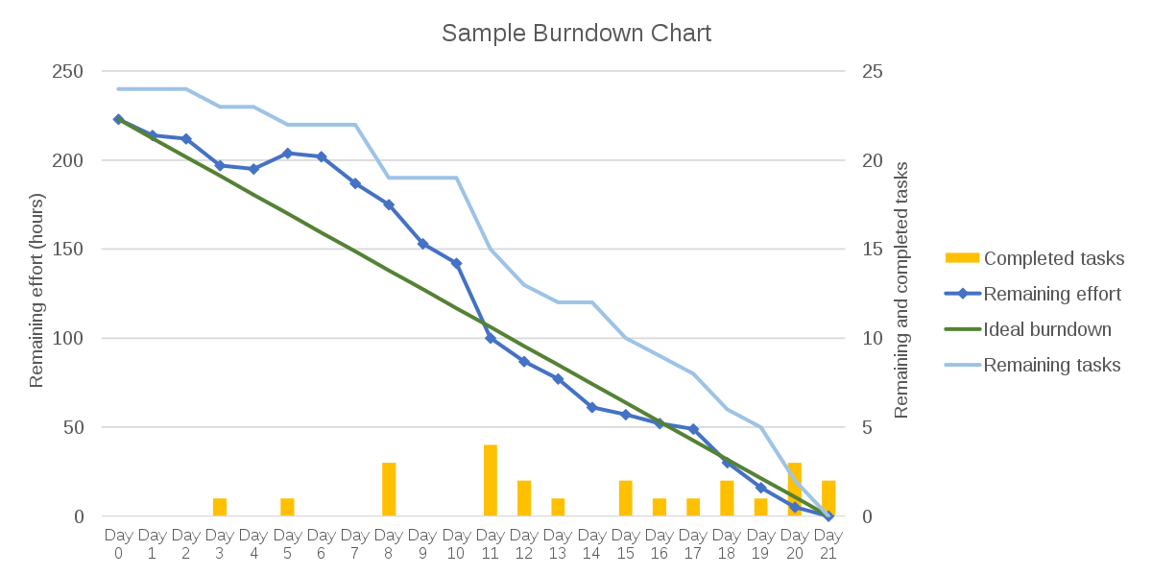
A Sprint Burndown Chart
www.rkinfotechindia.com

Slide 57
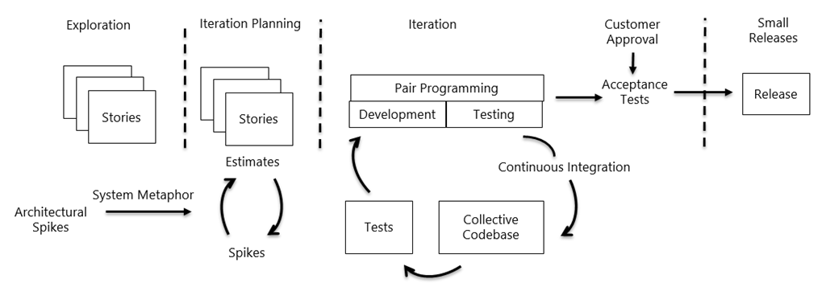
Extreme Programming (XP)
www.rkinfotechindia.com

Slide 58
Scrum vs XP
Scrum teams typically work in iterations (called sprints) that are from two weeks to one month long.
Scrum product owner prioritizes the product backlog but the team determines the sequence in which they will develop
Scrum teams do not allow changes into their sprints.
Scrum doesn't prescribe any engineering practices
XP teams typically work in iterations that are one or two weeks long.
XP teams work in a strict priority order.
XP teams are much more amenable to change within their iterations.
XP prescribes engineering practices, particularly things like test-driven development, the focus on automated testing, pair programming, simple design, refactoring.
www.rkinfotechindia.com

Slide 59
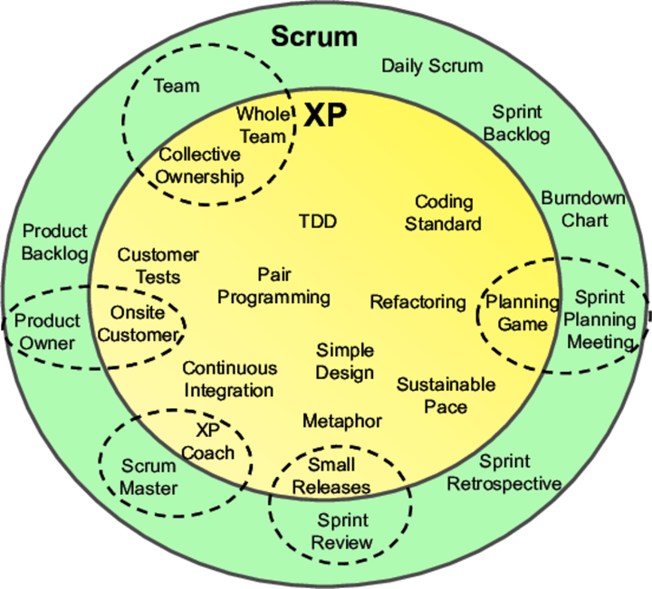
Hybrid Scrum with XP
www.rkinfotechindia.com

Slide 60
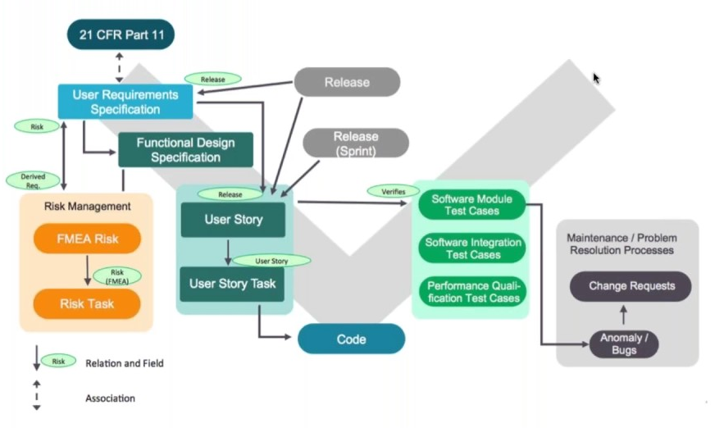
Hybrid Process Model
www.rkinfotechindia.com

Slide 61
Agile Documentation

Slide 62
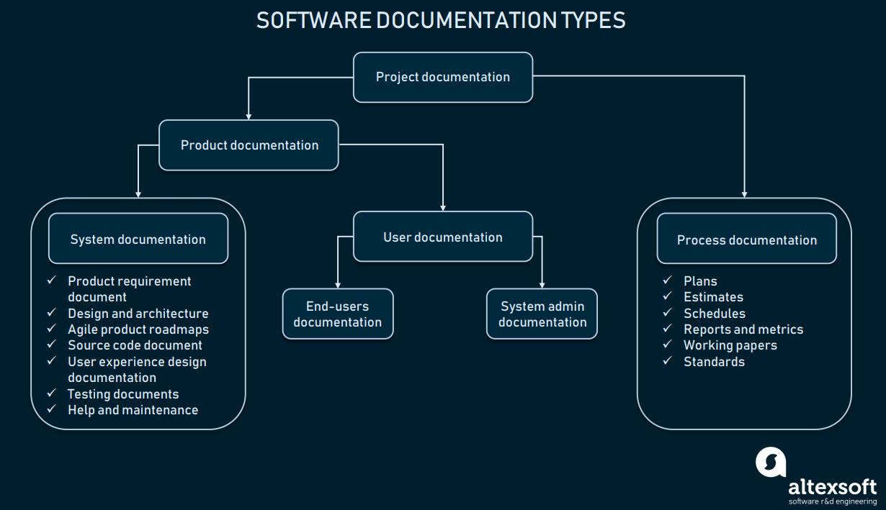
www.rkinfotechindia.com

Slide 63
Product Documentation
It describes the product that is being developed and provides instructions on how to perform various tasks with it. In general, product documentation includes requirements, tech specifications, business logic, and manuals.
System documentation represents documents that describe the system itself and its parts. It includes requirements documents, design decisions, architecture descriptions, program source code, and FAQs.
User documentation covers manuals that are mainly prepared for end-users of the product and system administrators. User documentation includes tutorials, user guides, troubleshooting manuals, installation, and reference manuals.
www.rkinfotechindia.com

Slide 64
Process Documentation
It represents all documents produced during development and maintenance that describe… well, the process. The common examples of process-related documents are standards, project documentation, such as project plans, test schedules, reports, meeting notes, or even business correspondence.
The main difference between process and product documentation is that the first one record the process of development and the second one describes the product that is being developed.
www.rkinfotechindia.com

Slide 65
Important Documents
User Story Map
Site Map Document
Product Road Map
User Flow Document / User Journey Schemes
Wireframe Document
Architecture Document
Yet there are many more documents can be covered that will help all member to analyze the required system properly before being developed.
www.rkinfotechindia.com

Slide 66
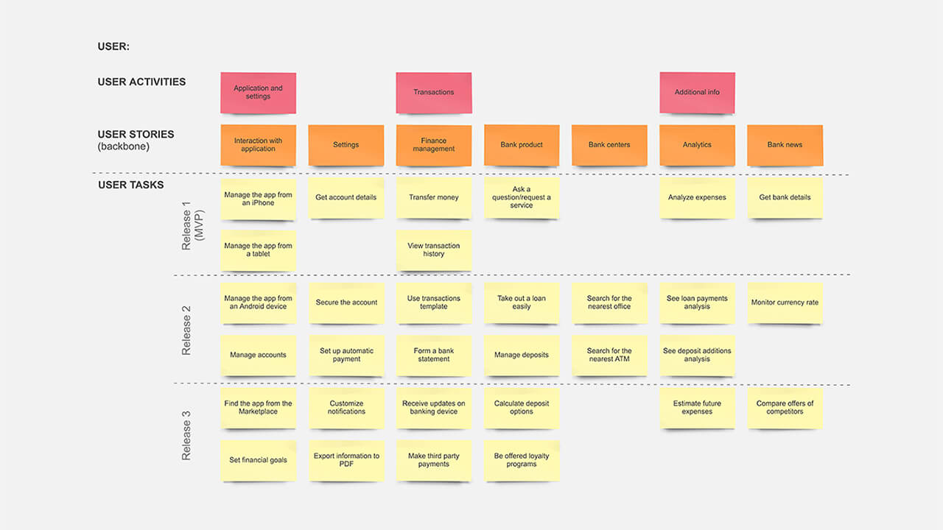
User Story Map

Slide 67
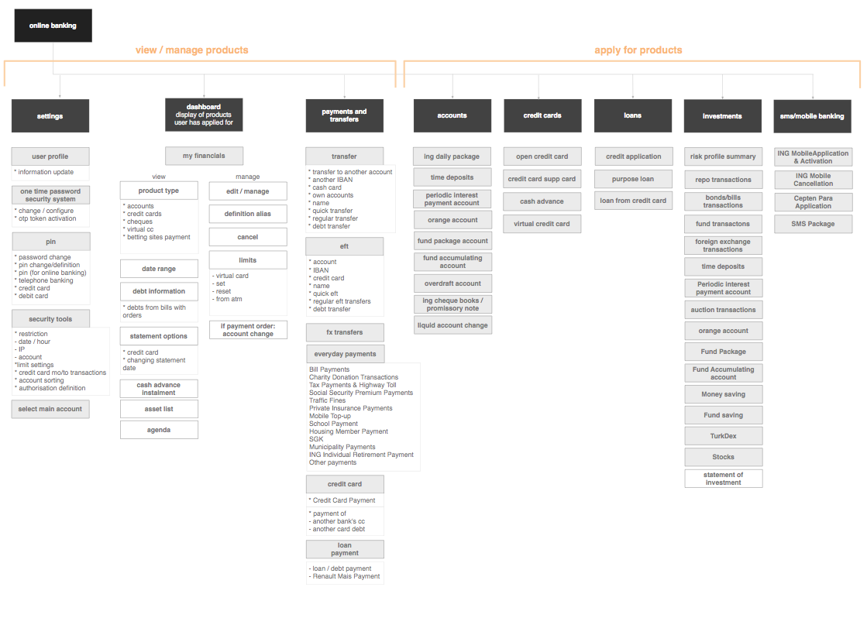
Site Map Document

Slide 68
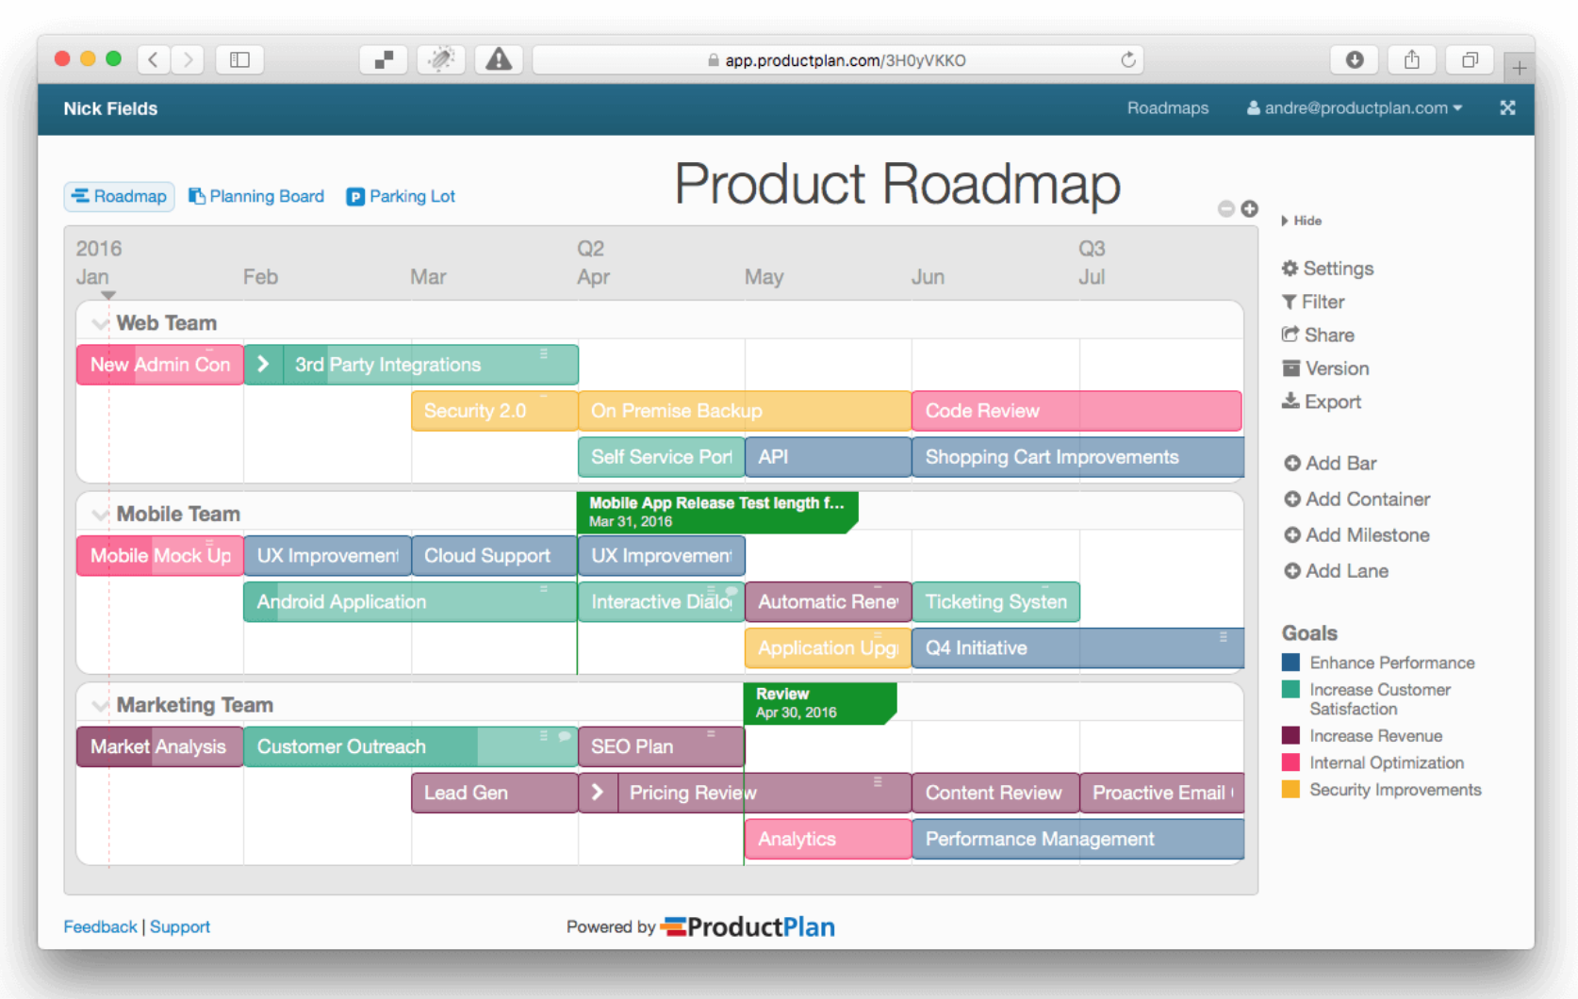

Slide 69
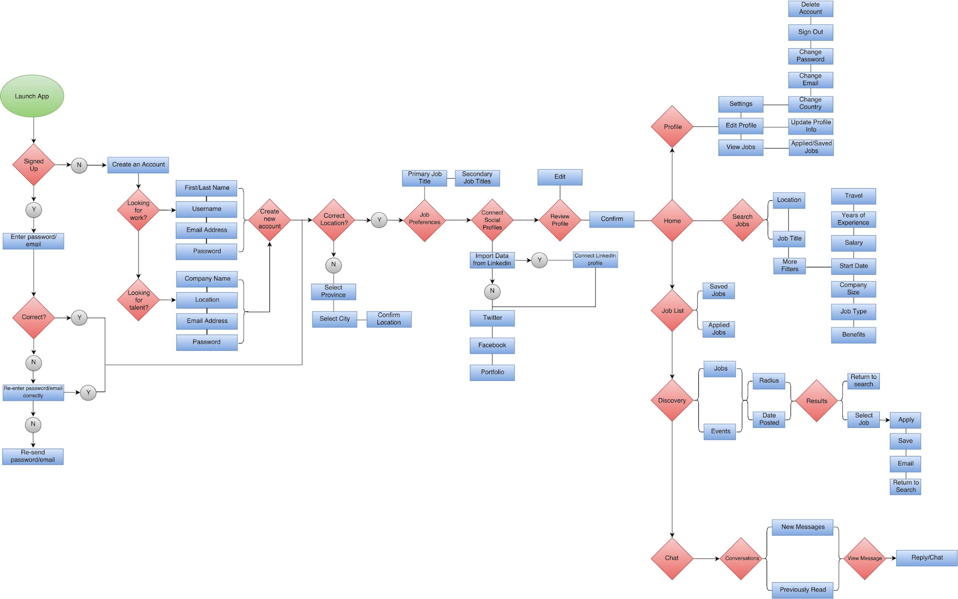
User Flow Document

Slide 70
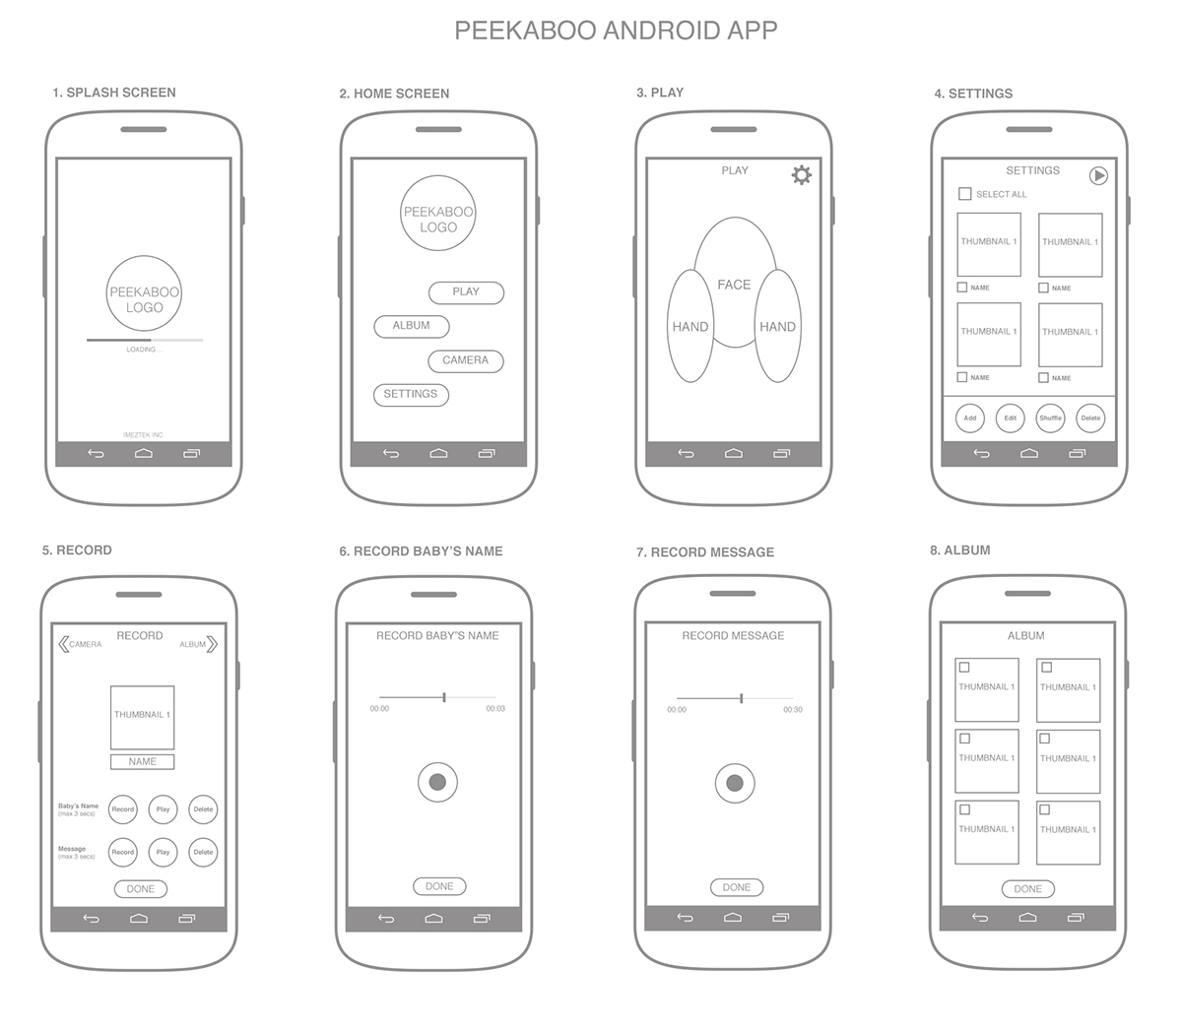
Wireframe Document

Slide 71
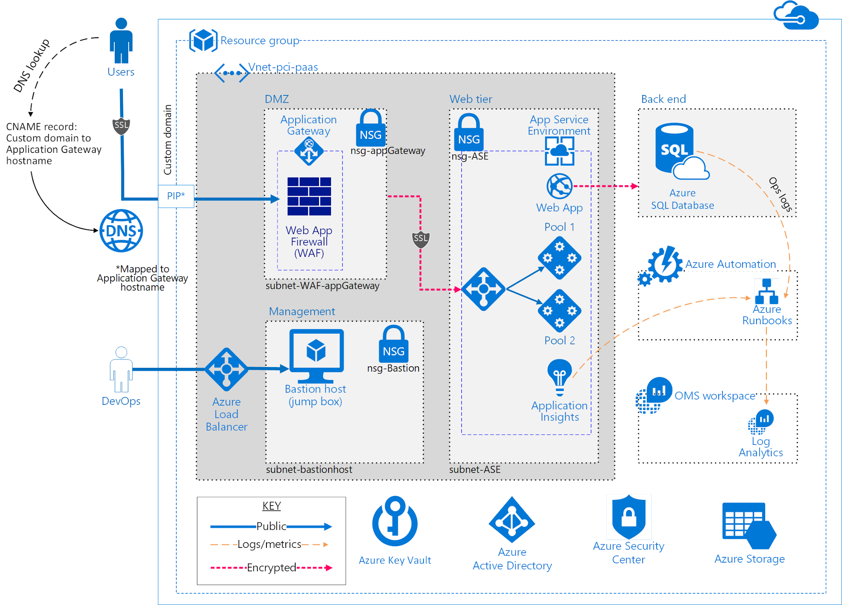
Architecture Document

Slide 72
Project Scalability
Typical individual team is 7 ± 2 people
  Scalability comes from teams of teams
Factors in scaling
  Type of application
  Team size
  Team dispersion
  Project duration
Scrum has been used on multiple 500+ person projects
www.rkinfotechindia.com

Slide 73
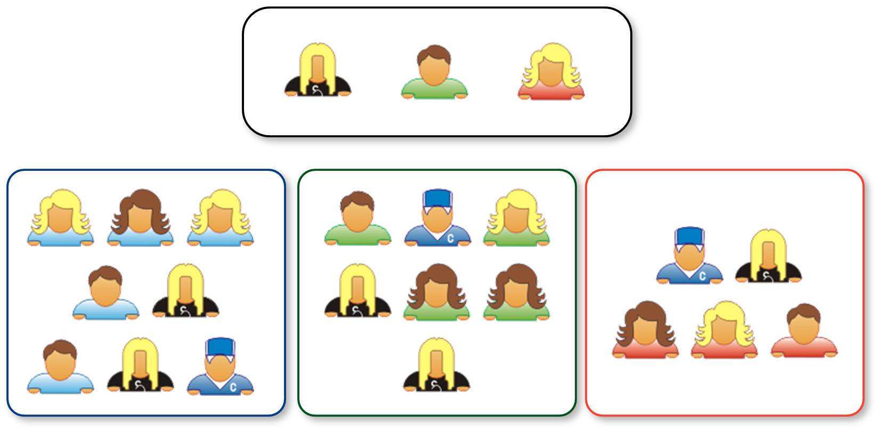
Scaling through the Scrum of scrums
www.rkinfotechindia.com

Slide 74
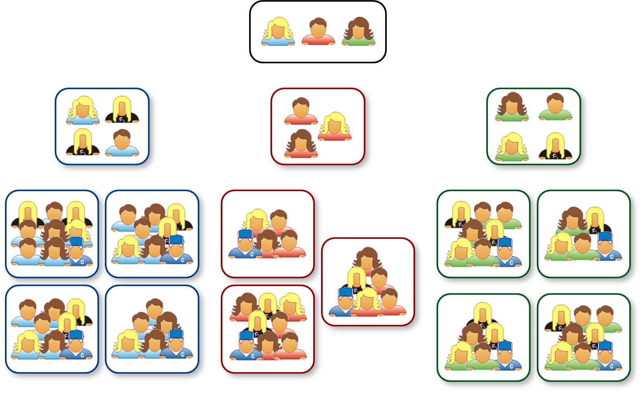
‘N’ Level of Scrums of Scrums
www.rkinfotechindia.com

Slide 75
Conclusion with Being Agile
It is about the people and teams
It is about customer and delivering software
It is about continuous improvement
www.rkinfotechindia.com

Slide 76

www.rkinfotechindia.com

Slide 77

SF-48 / 49 / 50, 3rd Floor, Shreemad Bhavan,
Opp. Kanta Vikas Gruh, Bhaktinagar Main Road,
Rajkot 360002 (Gujarat) India
(+91) 91735 69325 | (+91) 94271 78991
info@rkinfotechindia.com
careers@rkinfotechindia.com
www.rkinfotechindia.com

